Slide 1
Comparison Charts Infographics
Is a great way to visualize information about users
5%
15%
5%
25%
VS
65%
35%
25%
25%
Sells
Purchases
Returns
Expenses

Slide 2
Comparison Charts Infographics
Is a great way to visualize information about users
Sales 2012
Sales 2013
Sales 2014
Business professionals like you connecting to share advice.
Business professionals like you connecting to share advice.
Business professionals like you connecting to share advice.

Slide 3
Comparison Charts Infographics
Is a great way to visualize information about users
2019
Business professionals like you connecting to share advice.
2020
Business professionals like you connecting to share advice.

Slide 4
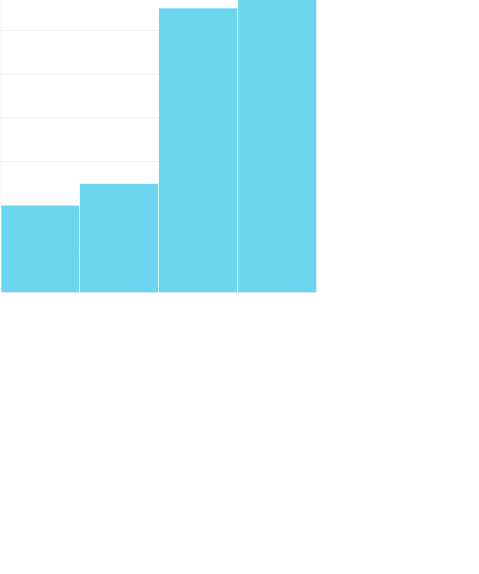

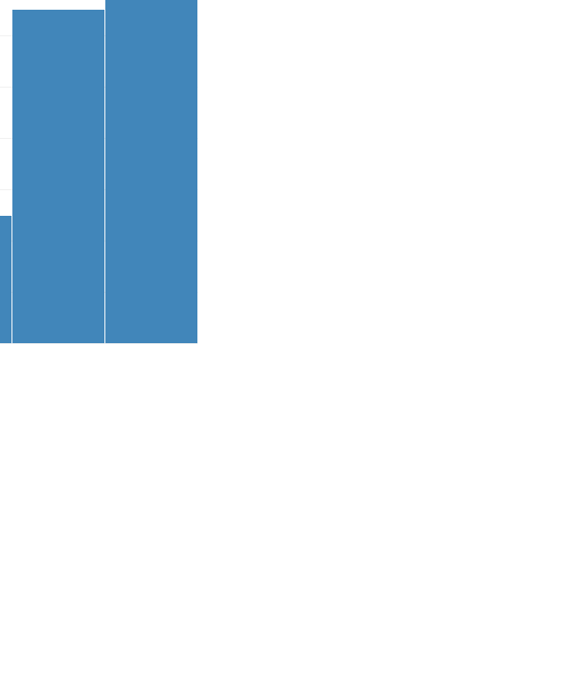

Comparison Charts Infographics
Is a great way to visualize information about users
Purchases 2019
Sells 2019
Returns 2019
Expenses 2019
Business professionals like you connecting to share advice.
Business professionals like you connecting to share advice.
Business professionals like you connecting to share advice.
Business professionals like you connecting to share advice.

Slide 5
Comparison Charts Infographics
Is a great way to visualize information about users
2018
2019
74%
65%
Employed
Employed
26%
35%
Unemployed
Unemployed

Slide 6
Comparison Charts Infographics
Is a great way to visualize information about users
2018
2019
VS

Slide 7
Comparison
Charts
Infographics
35%
65%
45%
Is a great way to visualize information
about users
2015
2016
2017
In Stock | 12 | 23 | 20
Purchased | 15 | 34 | 67
Sold | 87 | 34 | 12

Slide 8
Comparison Charts Infographics
Is a great way to visualize information about users
Store 1
Store 2
5%
5%
25%
65%
Sells
Purchases
Returns
Expenses

Slide 9
Comparison Charts Infographics
Is a great way to visualize information about users
Purchases
Sell
Returns
Expenses

Slide 10
Comparison Charts Infographics
Is a great way to visualize information about users
30%
48%
45%
Sells
Purchases
25%
52%
Expenses
Company
Small Business
Business professionals like you connecting to share advice.
Business professionals like you connecting to share advice.

Slide 11
Comparison Charts Infographics
Is a great way to visualize information about users
2019
2020
Business professionals like you connecting to share advice.
Business professionals like you connecting to share advice.

Slide 12
Comparison Charts Infographics
Is a great way to visualize information about users
Sells 2010
Sells 2011
Sells 2012
Business professionals like you connecting to share advice.
Business professionals like you connecting to share advice.
Business professionals like you connecting to share advice.

Slide 13
Comparison Charts Infographics
Is a great way to visualize information about users
January
February
March
Business professionals like you connecting to share advice.
Business professionals like you connecting to share advice.
Business professionals like you connecting to share advice.

Slide 14
Comparison Charts Infographics
Is a great way to visualize information about users
2018
2019
2020
Business professionals like you connecting.
Business professionals like you connecting.
Business professionals like you connecting.

Slide 15
Comparison Charts Infographics
Is a great way to visualize information about users
Sells
Purchases
Returns
Business professionals like you connecting to share advice.
Business professionals like you connecting to share advice.
Business professionals like you connecting to share advice.

Slide 16
Comparison Charts Infographics
Is a great way to visualize information about users
Achievements
Business professionals like you connecting to share advice.
Awards
Business professionals like you connecting to share advice.

Slide 17
Comparison Charts Infographics
Is a great way to visualize information about users
+50% Sells
Business professionals like you connecting to share advice.
-25% Purchases
Business professionals like you connecting to share advice.
10% Returns
Business professionals like you connecting to share advice.

Slide 18
Comparison Charts Infographics
Is a great way to visualize information about users
VS
70%
Engineers
60%
50%
Lawyers
70%
30%
Doctors
70%

Slide 19
Comparison Charts Infographics
Is a great way to visualize information about users
Gold
Silver
Bronze
Features
Premium Quality
Easy to Use
Different Sizes

Slide 20
Comparison Charts Infographics
Is a great way to visualize information about users
VS
Purchases 2019
Purchases 2020
Business professionals like you connecting to share advice.
Business professionals like you connecting to share advice.

